Slide 1
Fake News Détection using NLP
Author :
Parija Deshmukh

Slide 2
Fake News classification using NLP
In our modern era where the internet is ubiquitous, everyone relies on various online resources for news. Along with the increase in the use of social media platforms like Facebook, Twitter, etc. news spread rapidly among millions of users within a very short span of time. The spread of fake news has far-reaching consequences like the creation of biased opinions to swaying election outcomes for the benefit of certain candidates.
Spammers use appealing news headlines to generate revenue using advertisements via click-baits.
In this project, we aim to perform binary classification of various news articles with the help of concepts pertaining to Natural Language Processing and Machine Learning.
We aim to provide the user with the ability to classify the news as fake or real.

Slide 3
Problem Statement
Our goal is to build a prototype of robust real-time fake news classifier that can efficiently and correctly flag the news, if it is a fake news or looks like a fake news so that it can be controlled and restricted.

Slide 4
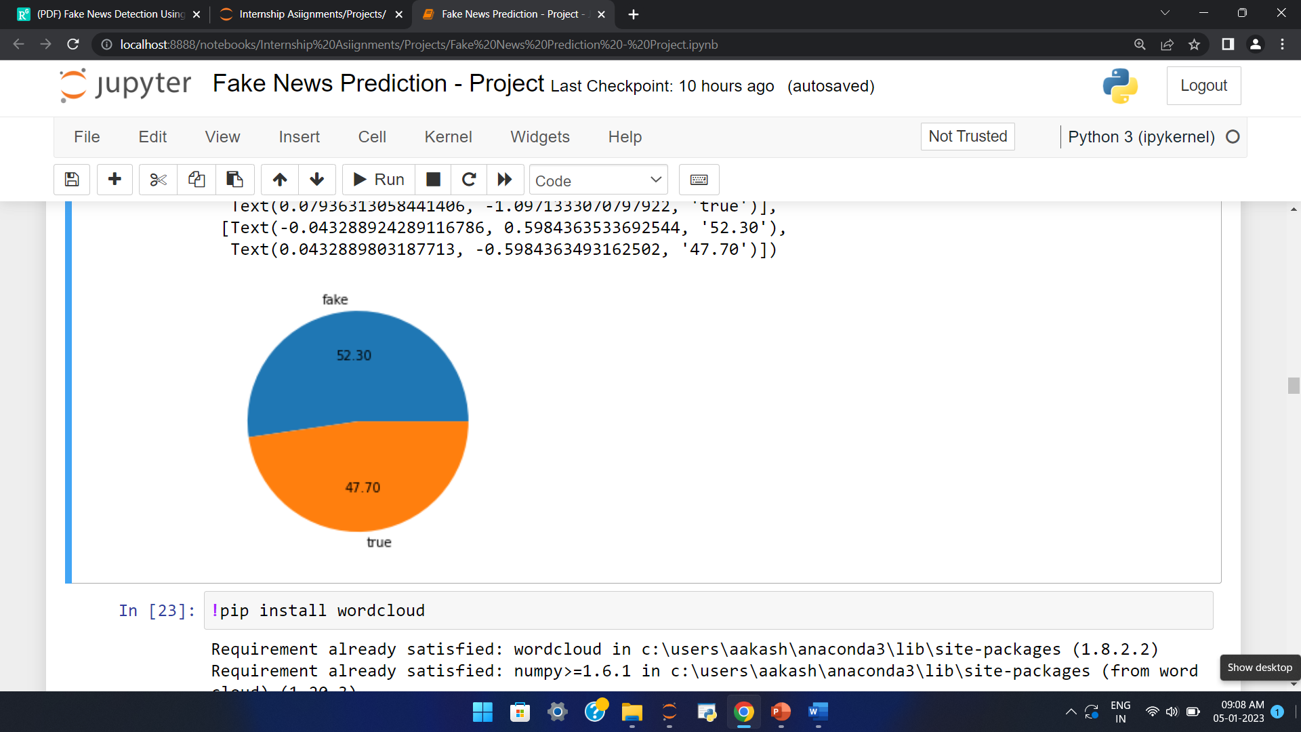
Exploration of Target Variable Ratings
Out of total news around 47.70% news are true and 52.30% are fake news.

Slide 5
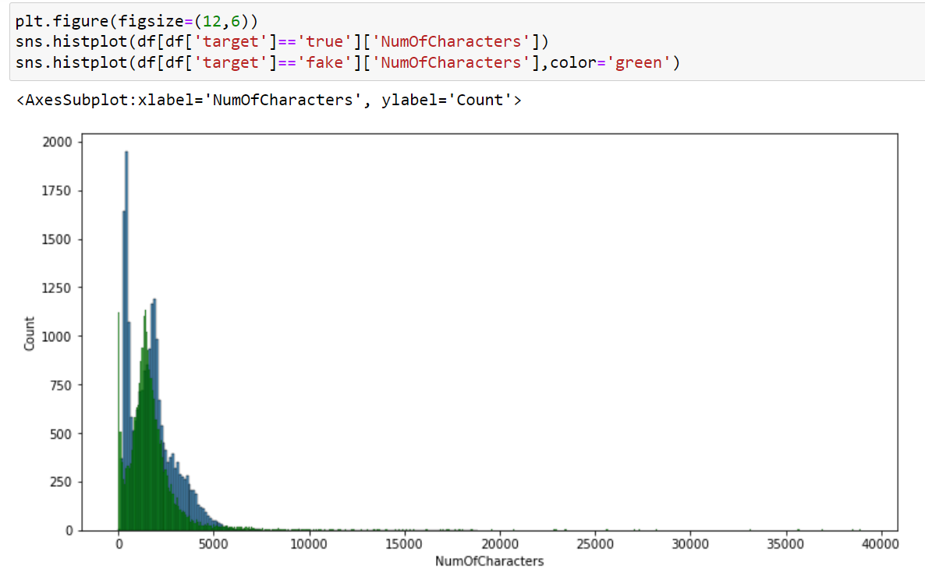
Above is a plot showing the comparison between number of characters real/fake news consists of.
Majority of the fake news contains greater number of characters.

Slide 6
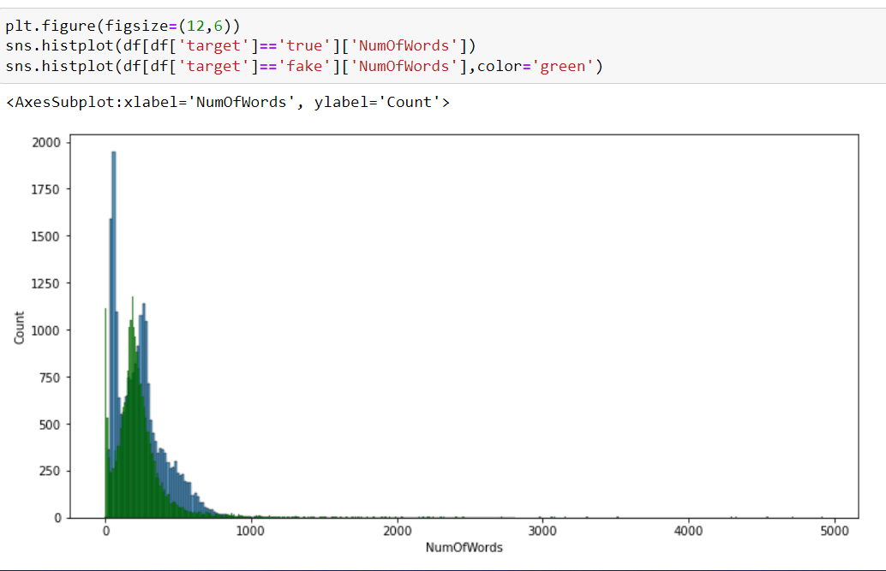
Above is a plot showing the comparison between number of words real/fake news consists of.
Majority of the fake news contains greater number of words.

Slide 7
Data Pre Processing
Convert the text to lowercase
Remove the punctuations, digits and special characters
Tokenize the text, filter out the adjectives used in the review
Remove the stop words
Stemming and Lemmatising
Applying Text Vectorization to convert text into numeric.

Slide 8
Word Cloud

Slide 9
Word Cloud for getting word sense
Word Cloud is a visualization technique for text data wherein each word is picturized with its importance in the context or its frequency.
The more commonly the term appears within the text being analysed, the larger the word appears in the image generated.
The enlarged texts are the greatest number of words used there and small texts are the smaller number of words used.

Slide 10
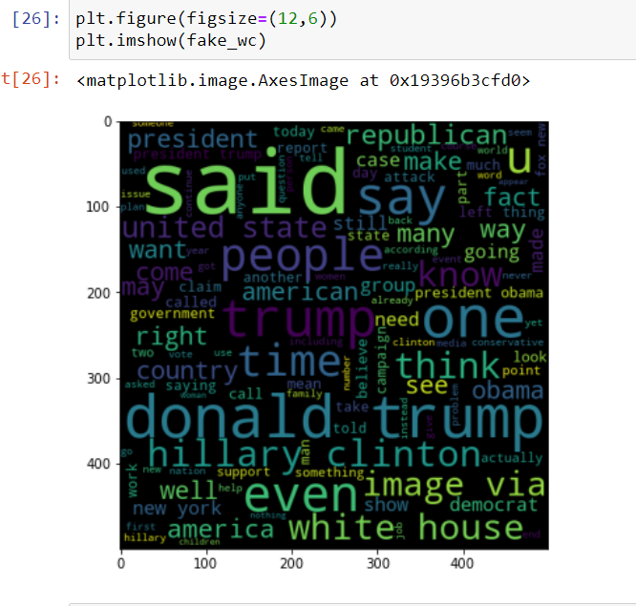
From word cloud of fake news classification, it is clear that it mostly consists of words like think, time, said, something etc

Slide 11
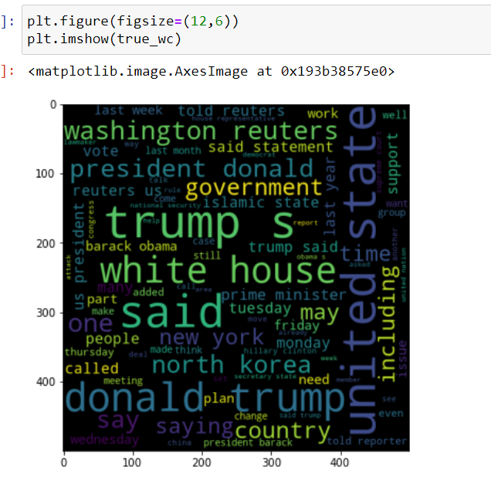
From word cloud of true news, it is clear that it mostly consists of words like government, said statement, Washington Reuters etc.

Slide 12
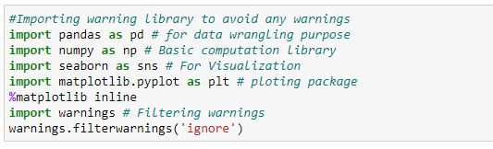
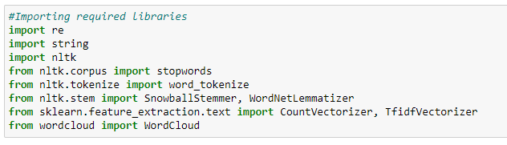
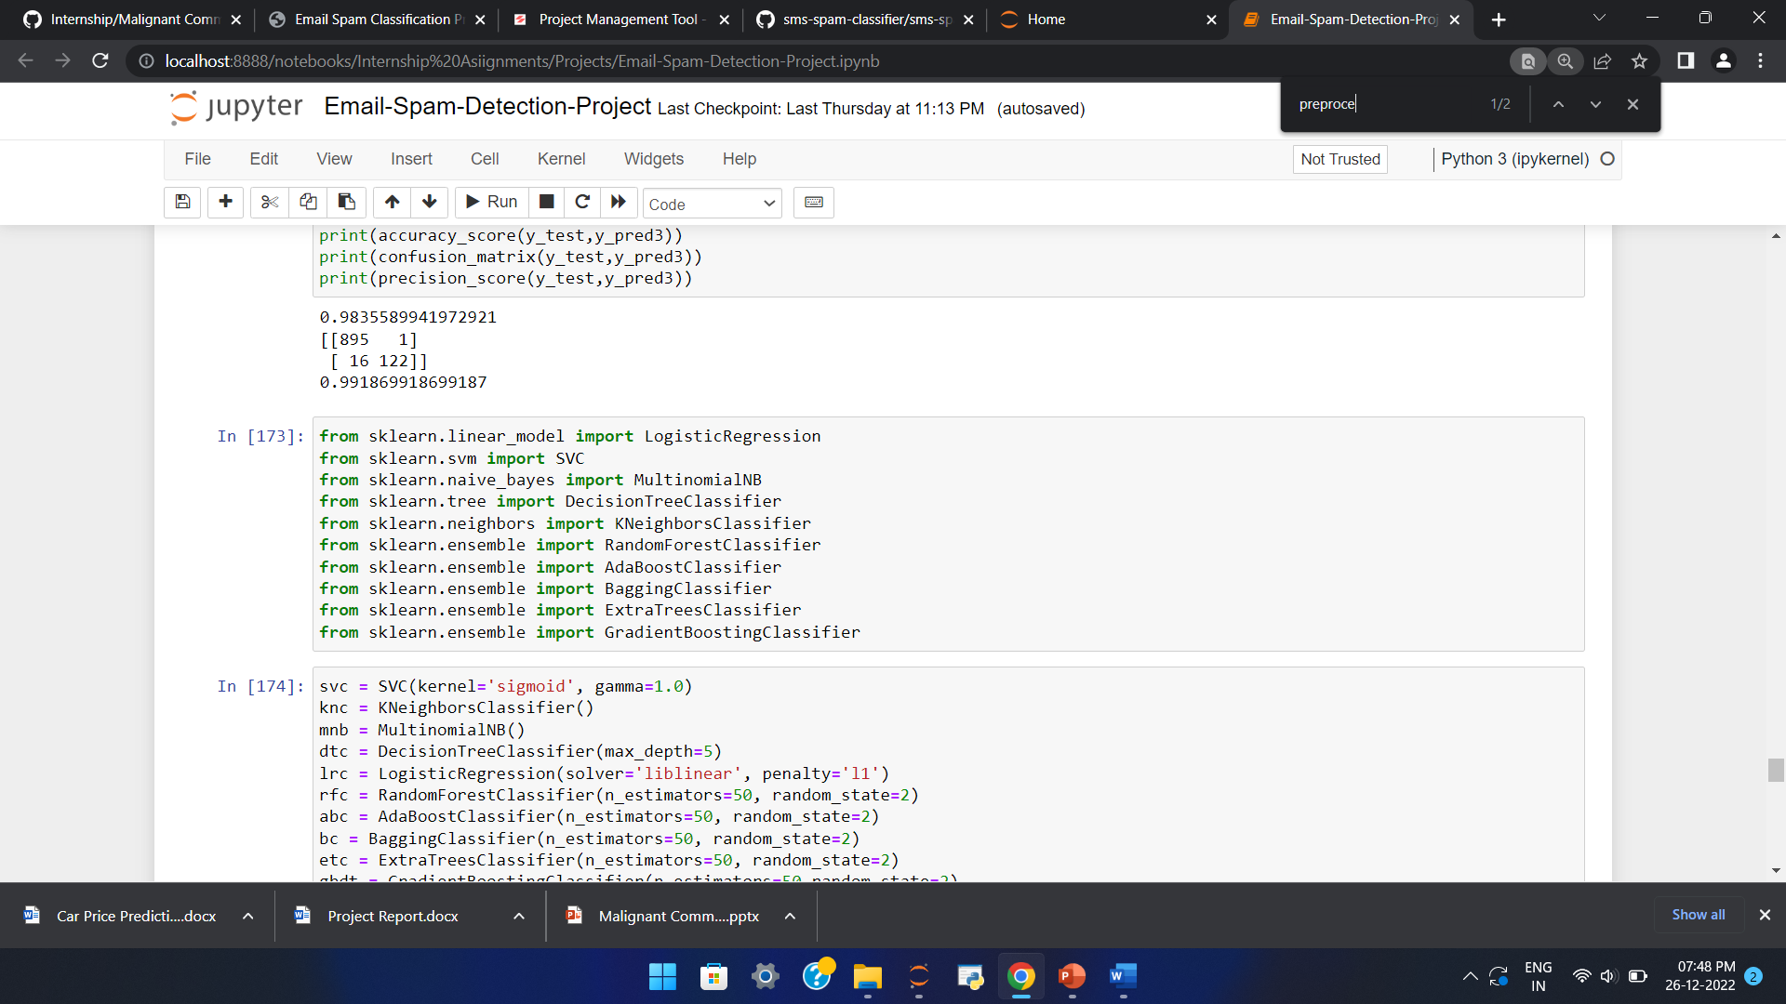
Visualization & Data Wrangling Library used
Text Mining Library used
Machine Learning Model Building Library used

Slide 13
Machine Learning Model Building

Slide 14
Machine Learning Model Building
The different classification algorithm used in this project to build ML model are as below:
Random Forest classifier
Support Vector Classifier
Logistics Regression
AdaBoost Classifier

Slide 15
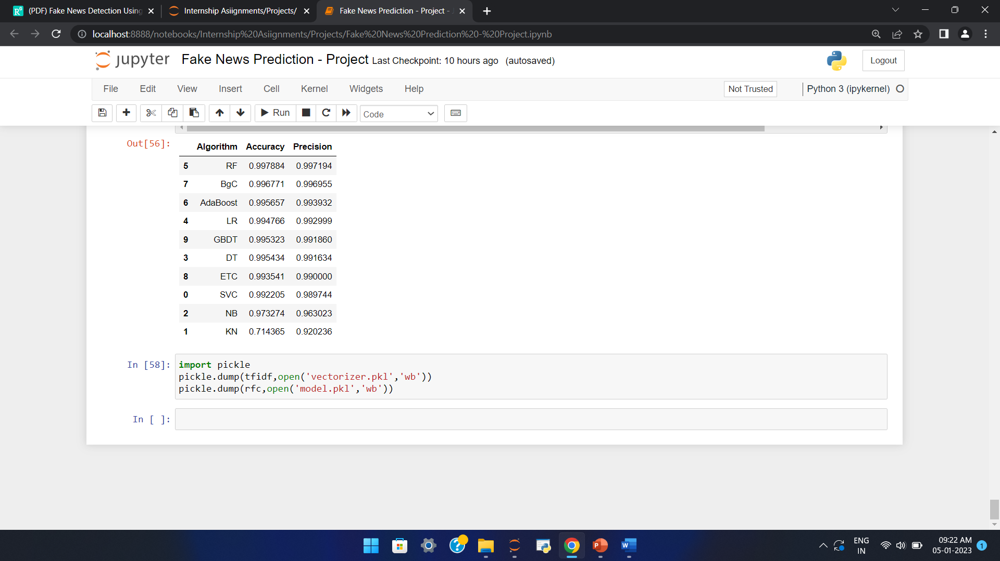
Final ML Model
Final Model - RF is giving us Accuracy score of 99.78% with 99.71% precision.

Slide 16
CONCLUSION
Random Forest Classifier performs better with Accuracy Score: 99.78 % and precision of 99.71% than the other classification models.

